Slide 1
Cover Crops and Weed Management Chris Proctor, UNL Weed Science Extension Educator

Slide 2
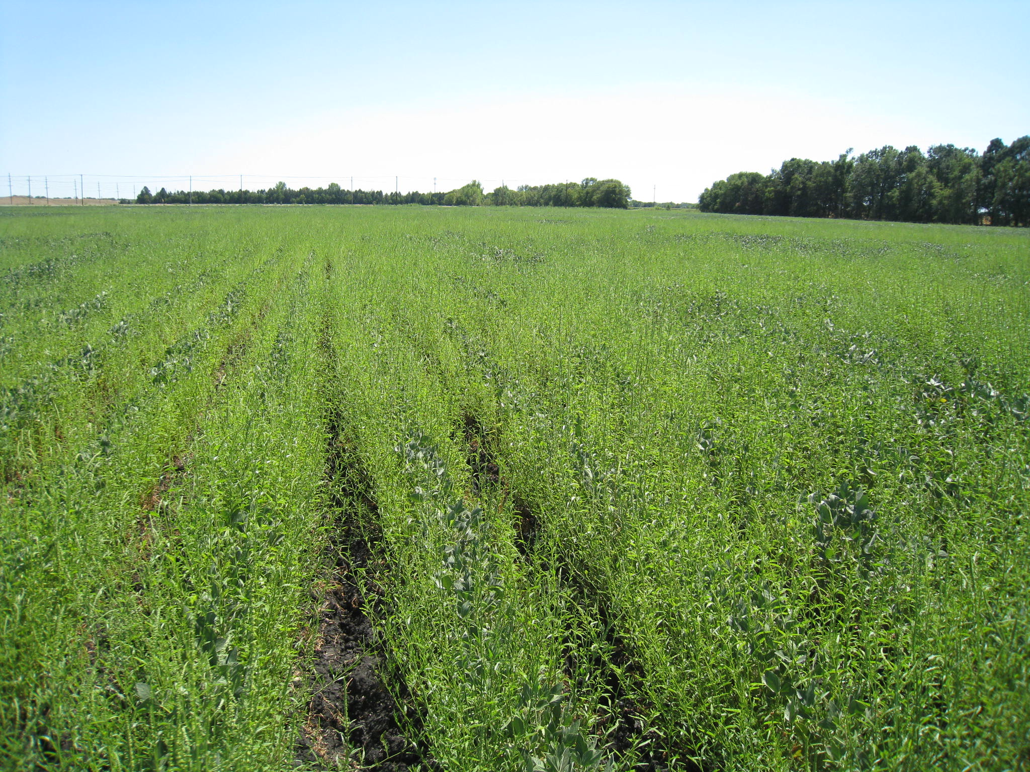
Waterhemp
BURNDOWN:
Durango (36 oz) + Valor (2 oz) + Prowl H₂0 (1 pt)
POST:
Durango (48 oz)
POST:
Flextar GT (44 oz) + Durango (16 oz)
POST:
Cobra (12 oz) + Resource (5 oz)
Interrow Cultivation
POST:
Ultra Blazer (1.5 pt)
Herbicide Cost: $94/a
Photo: 8/5/12
Notes:
Glyphosate
Flumioxazin
Pendimethalin
Glyphosate
Fomesafen
Glyphosate
Glyphosate
Lactofen
Flumiclorac
Acifluorfen

Slide 3

Cover Crop Survey Results - 82 participants (72 doing cover crops – 87%) - Total acres farmed/managed: 369,005 - Acres planted to cover crops: 59,892 - 32% area planted with cover crops (2.5-100%)
Notes:
Survey from Rodrigo Werle et al.

Slide 4
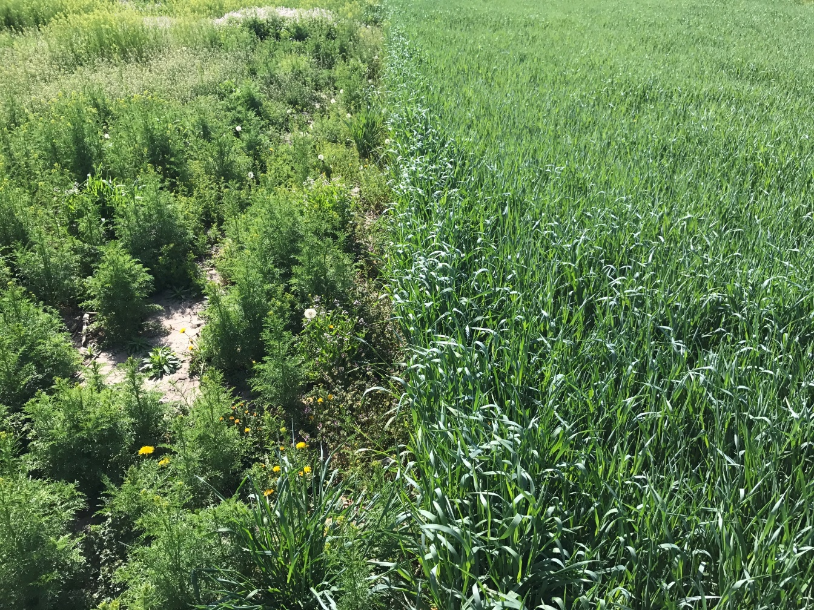
Improved Weed Control | %
Yes | 93
No | 7
Species | %
Winter Annual | 79
Early-Season Summer Annual | 26
Late-Season Summer Annual | 55

Slide 5
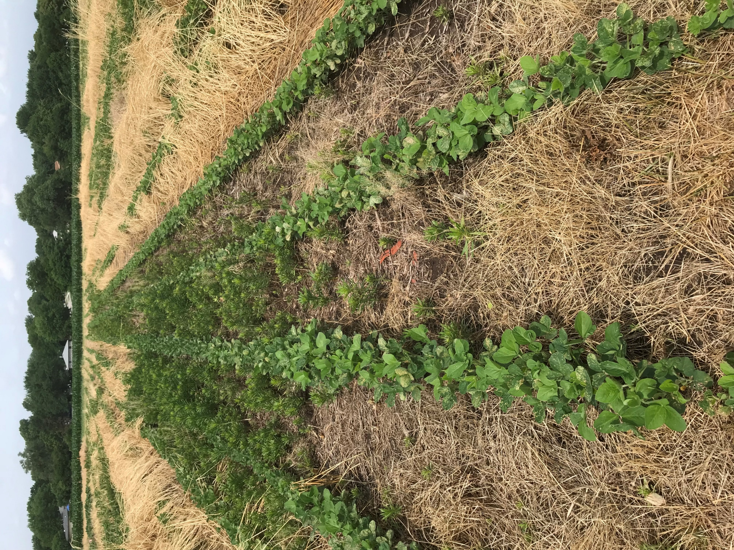
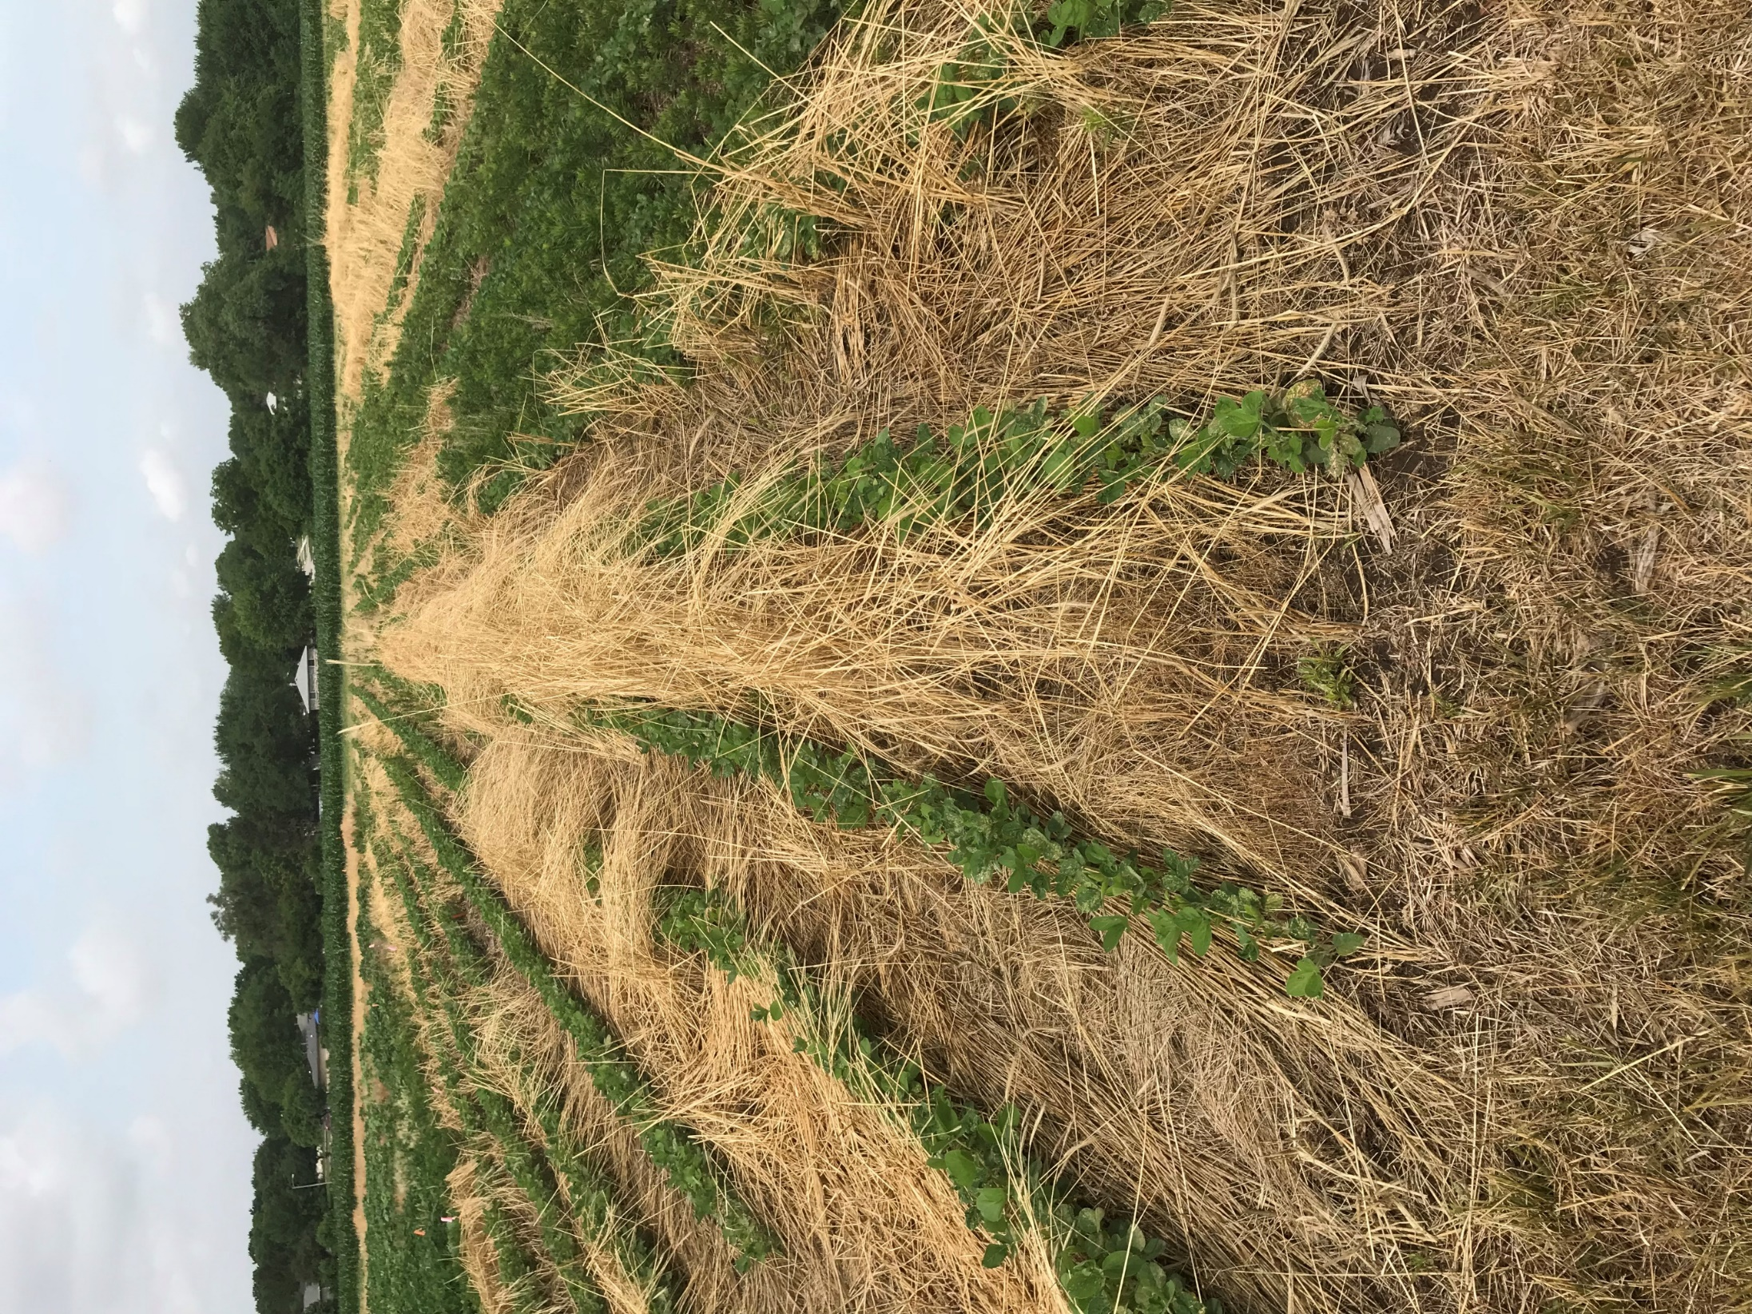
Planted 9/11/17
Terminated 6/1/18
Photo 6/18/18
Notes:
Herbicide Tie-up

Slide 6

Timing is Everything

Slide 7

Timing is Everything

Slide 8
Timing is Everything
What is the most important time to control weeds?

Slide 9
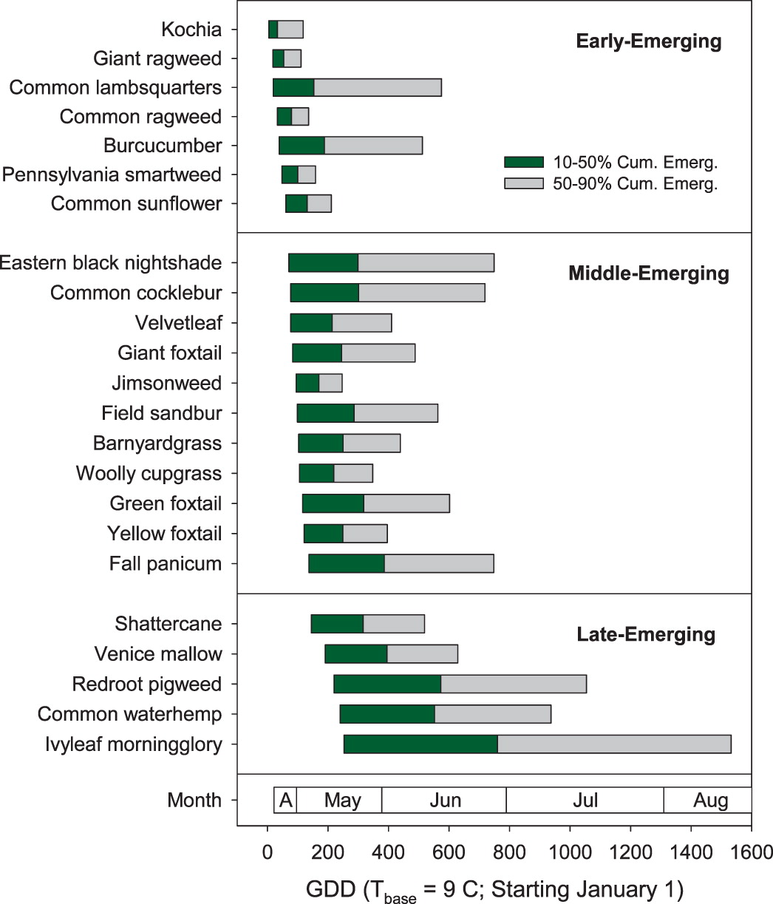

Slide 11
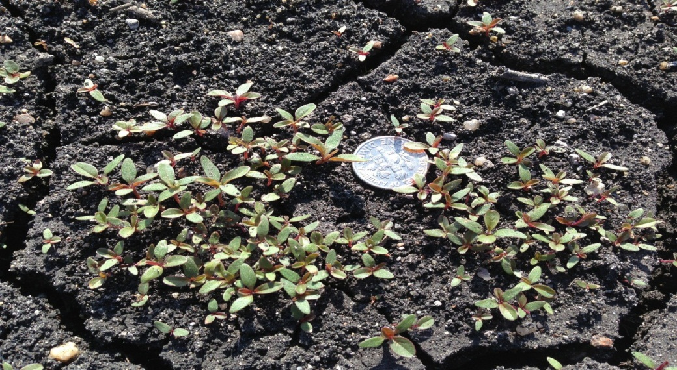
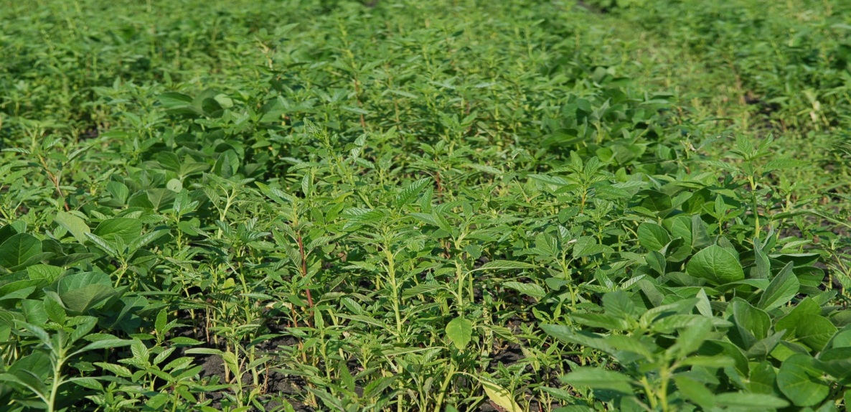
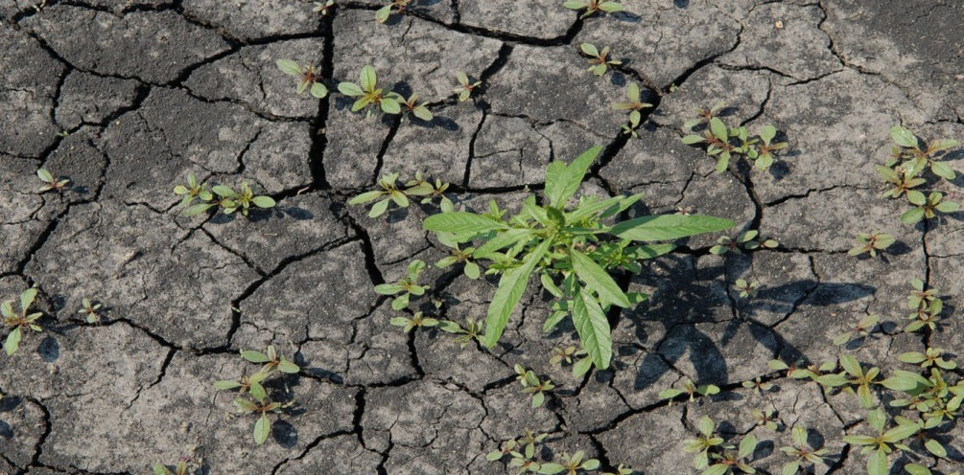
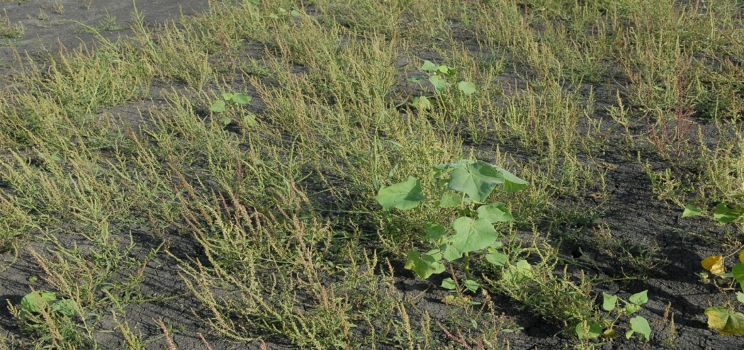
Emergence of common waterhemp in Nebraska
7th June
15th July
20th August
10th September

Slide 12
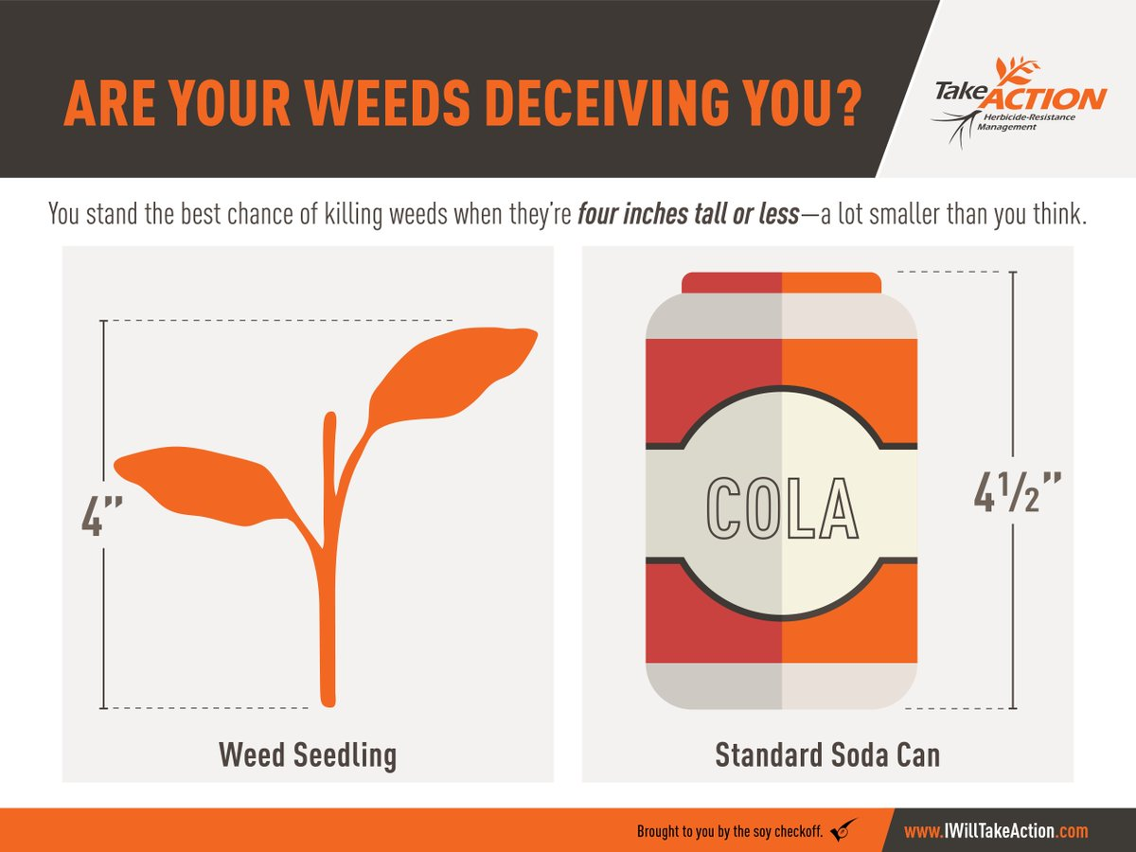

Slide 13
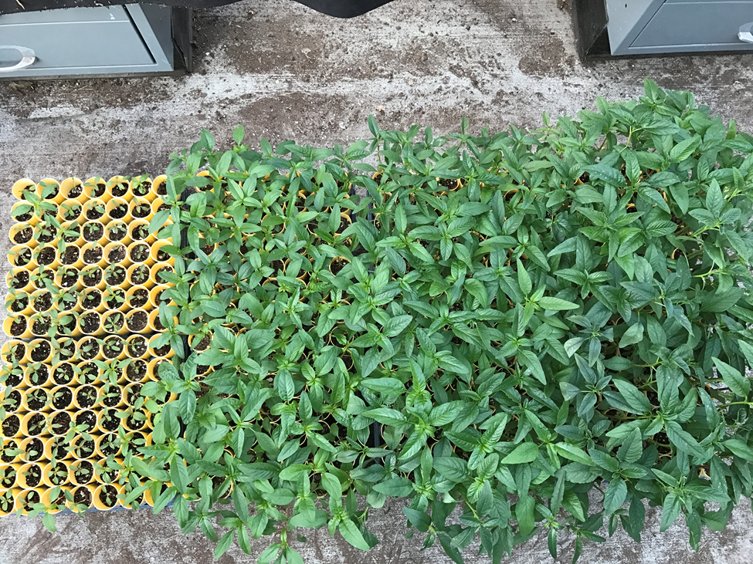
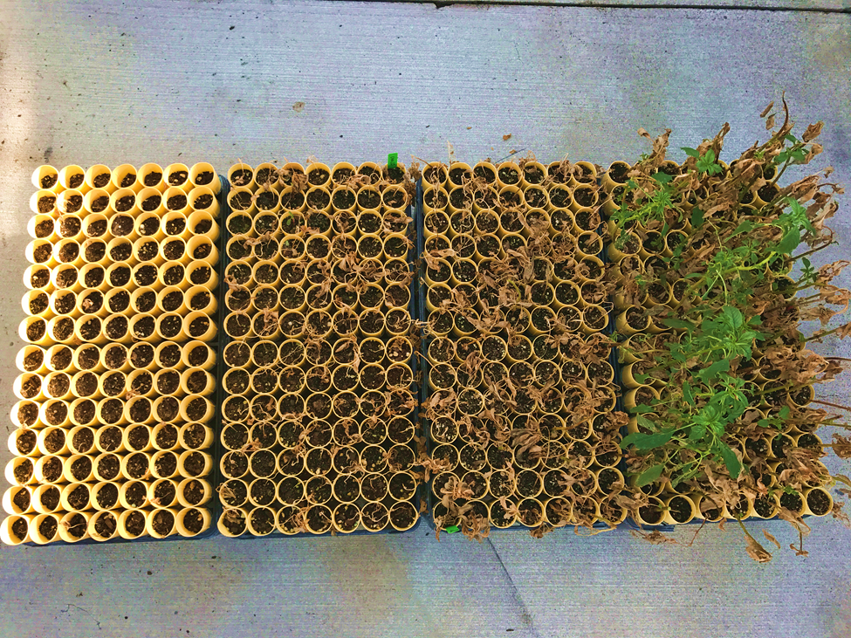
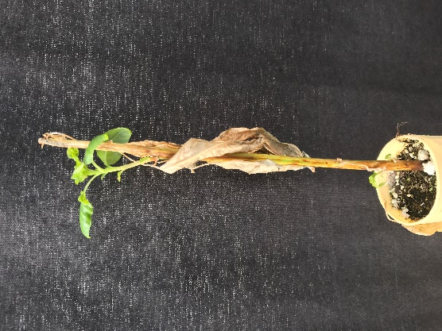
\
Waterhemp
Cobra: 12.5 fl oz/A
COC: 1 pt/A
AMS: 2.5 lbs/A
15 GPA
0 DAT
3”
6”
8”
11”
28 DAT

Slide 14
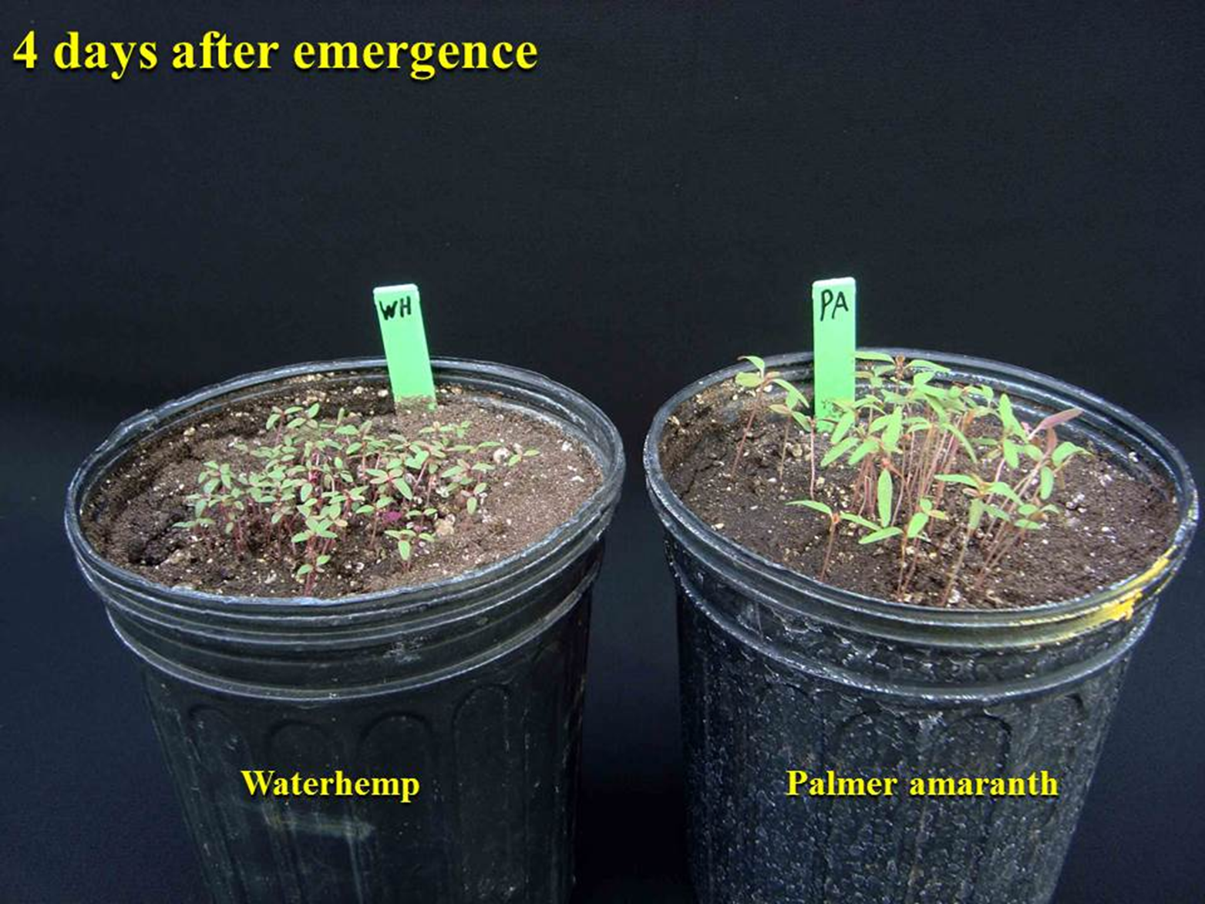

Slide 15
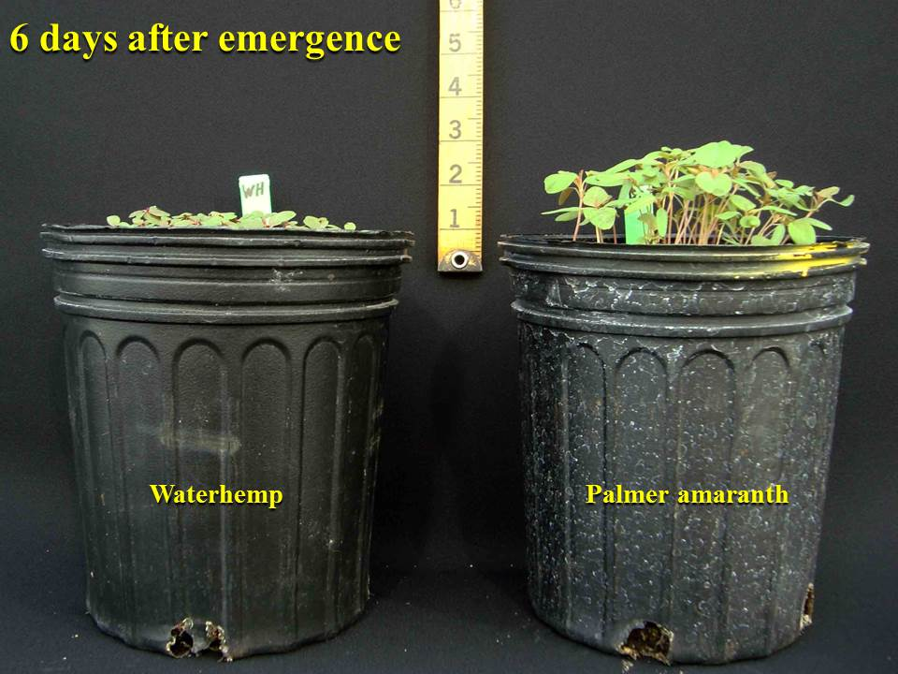

Slide 16
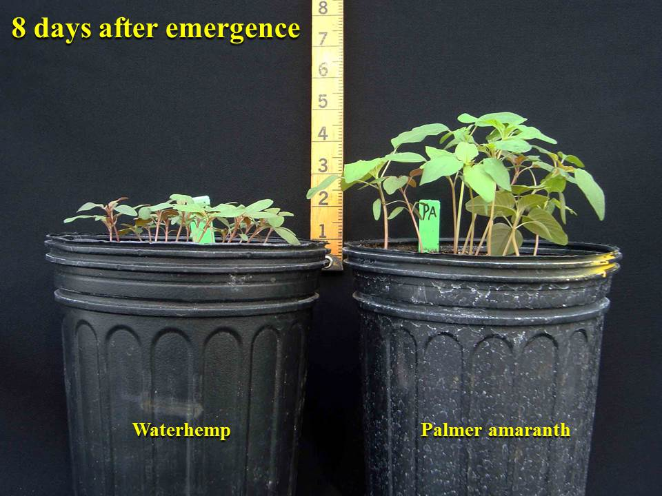

Slide 17
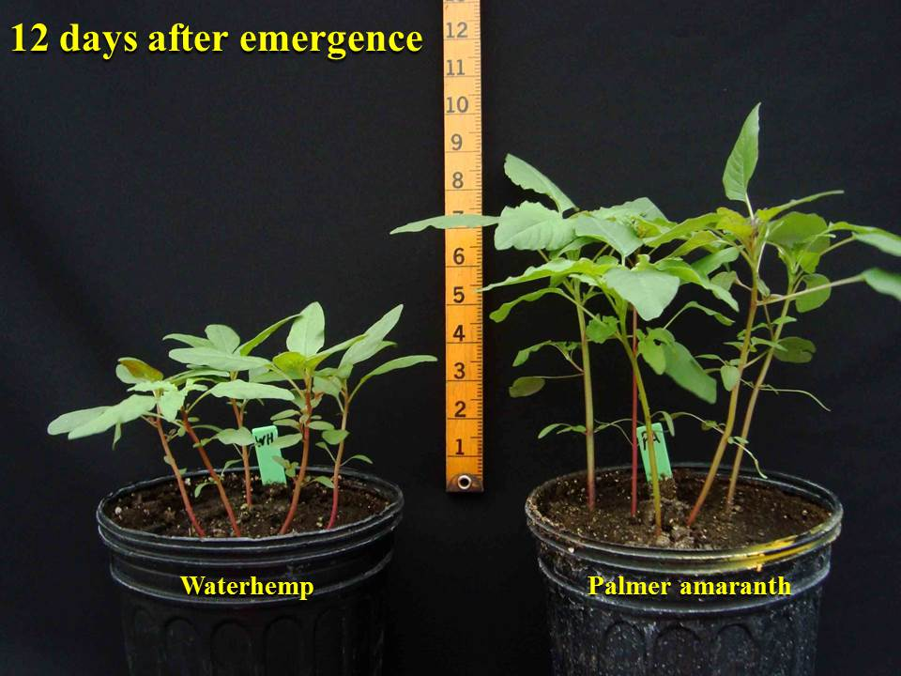

Slide 18
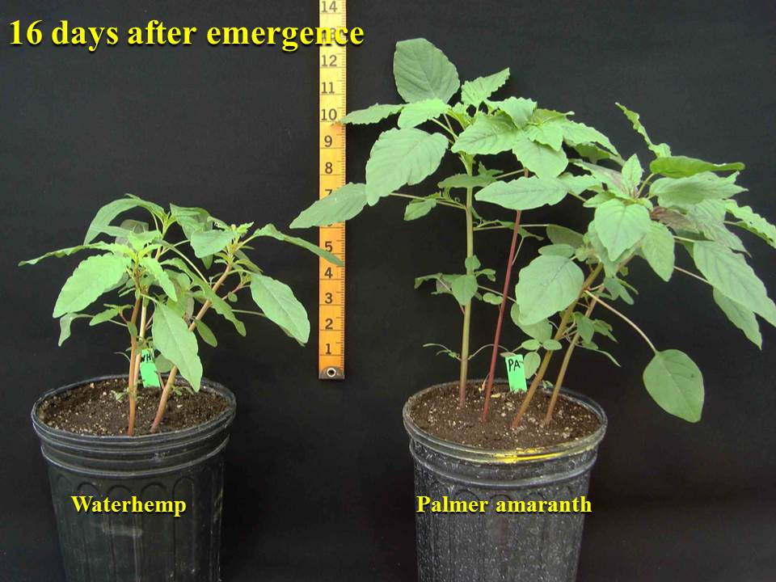

Slide 19
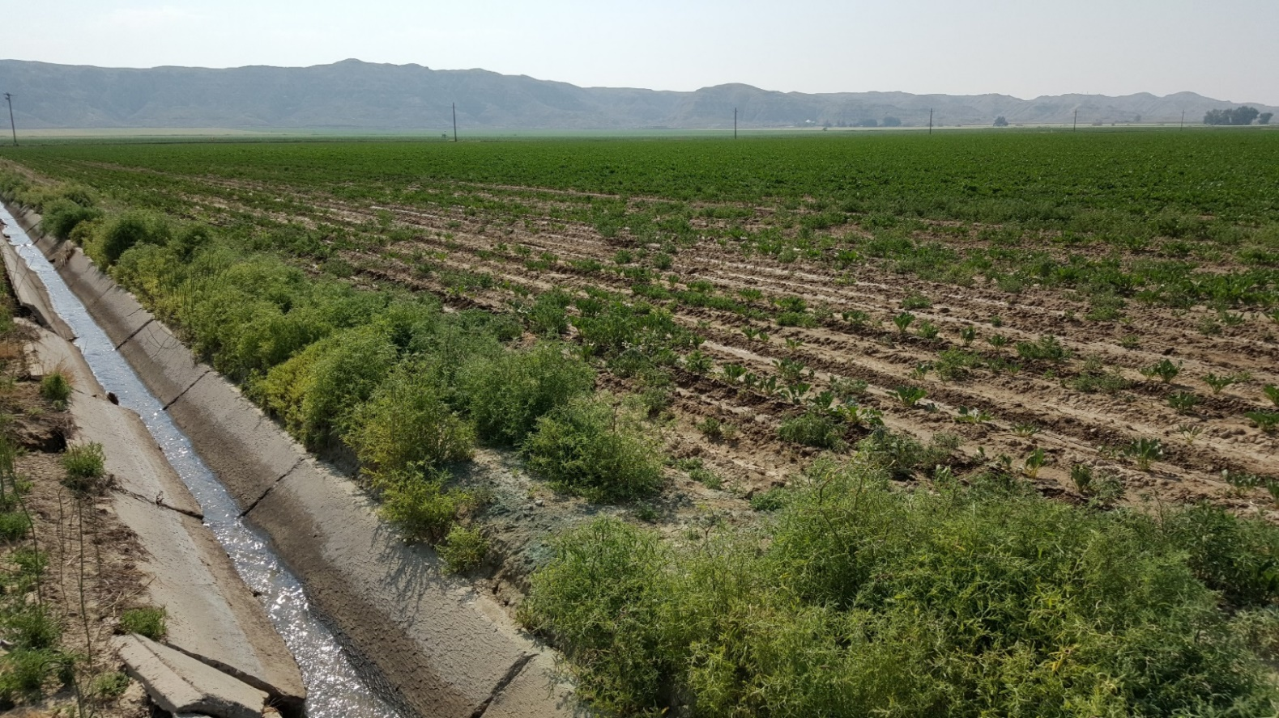
Prioritize
A. Kniss

Slide 20
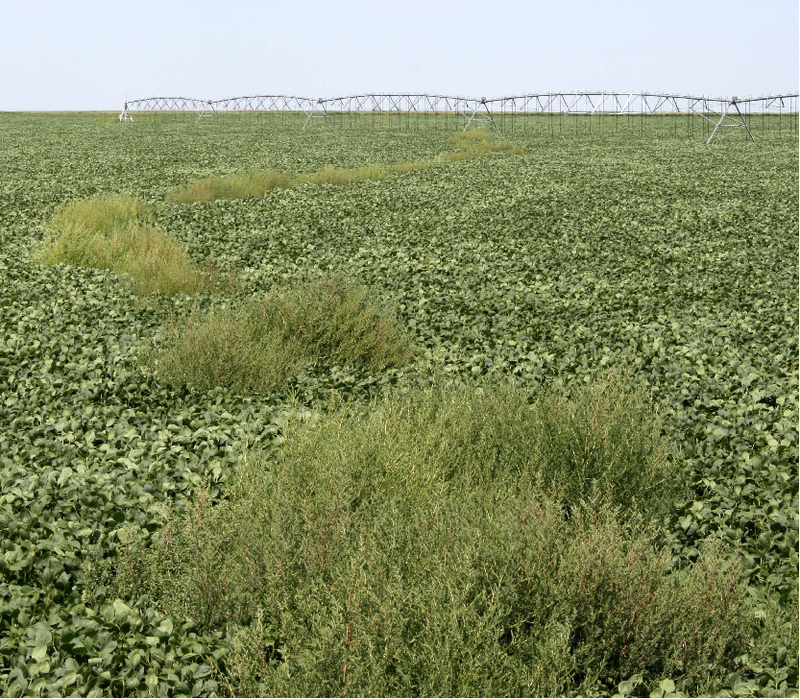
Prioritize
Photo: Phil Stahlman (KSU)

Slide 21
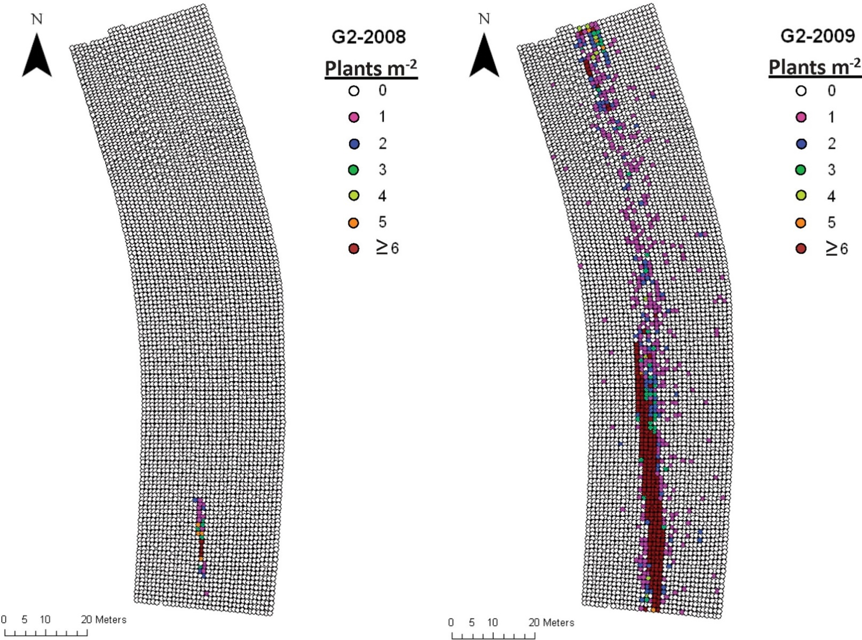
Norsworthy et al. (2014) Weed Sci. 62:237-249

Slide 22
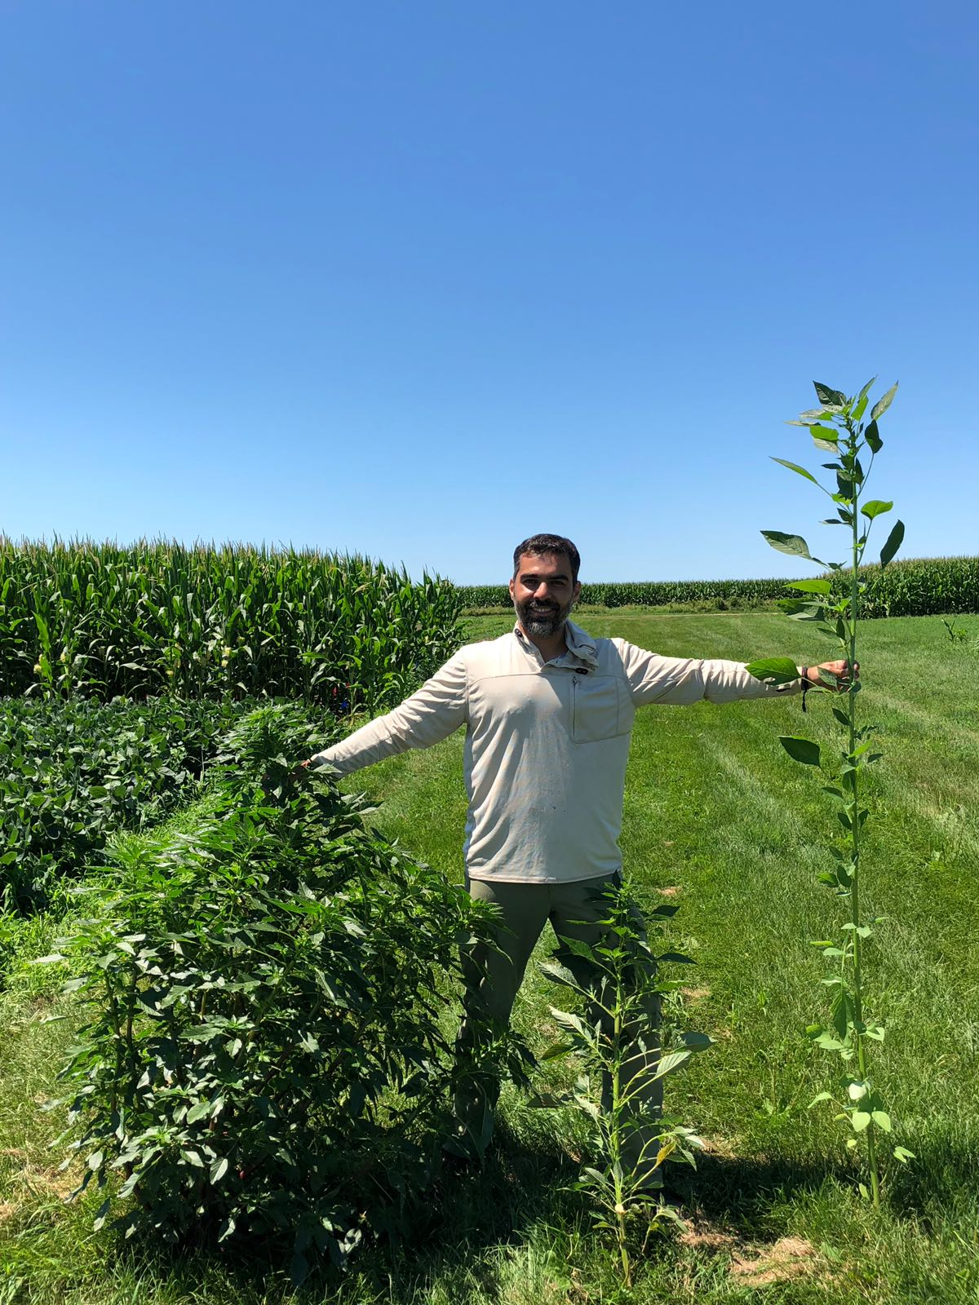
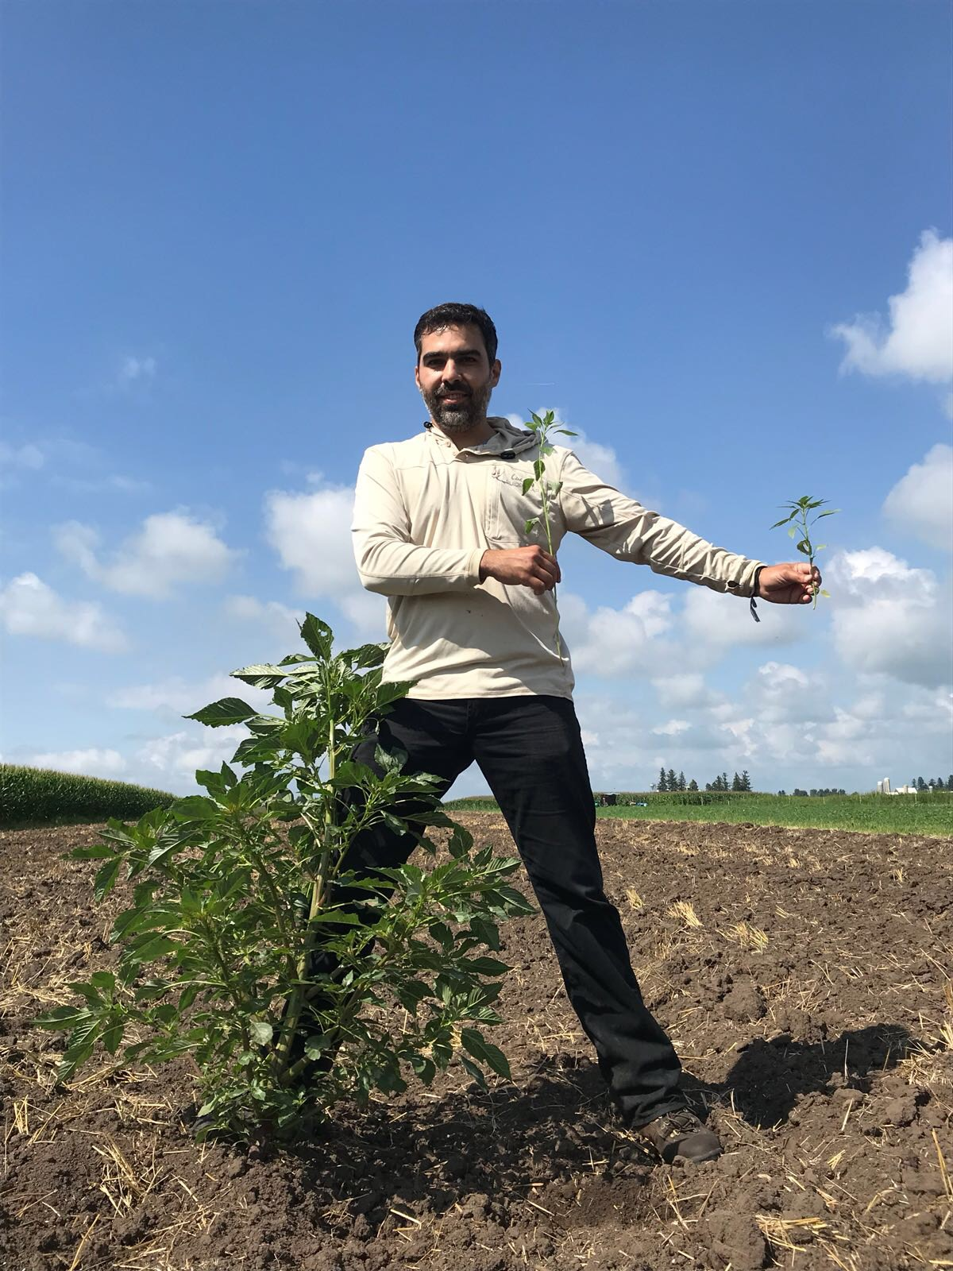
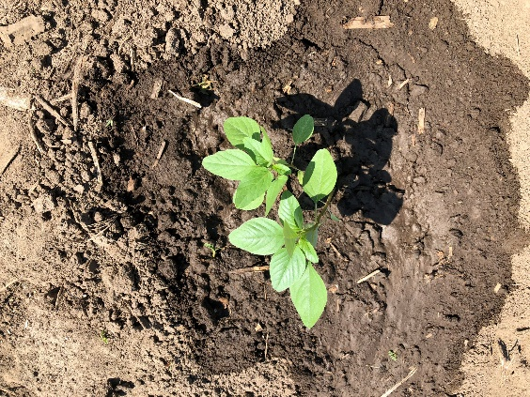
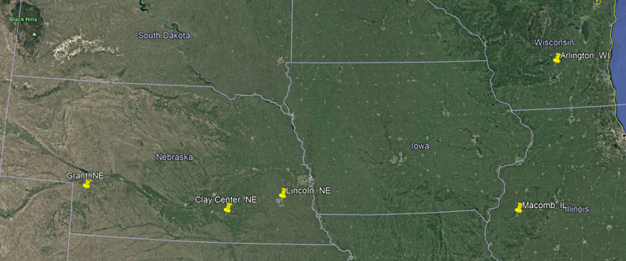

Palmer amaranth adaptation
Transplanted: June 01
Picture: July 16
Transplanted: July 01
Picture: August 02
SOY
CORN
FALLOW
SOY
CORN
FALLOW

Slide 23
Cover Crop Biomass and Planting Date
SCAL: Fall biomass (12/8/2015)
Spring biomass (04/14/2016)
Fall biomass (11/15/2016)
Spring biomass (04/11/2017)
Notes:
Cover crop planting dates are associated with approximate harvest dates for each hybrid.

Slide 24
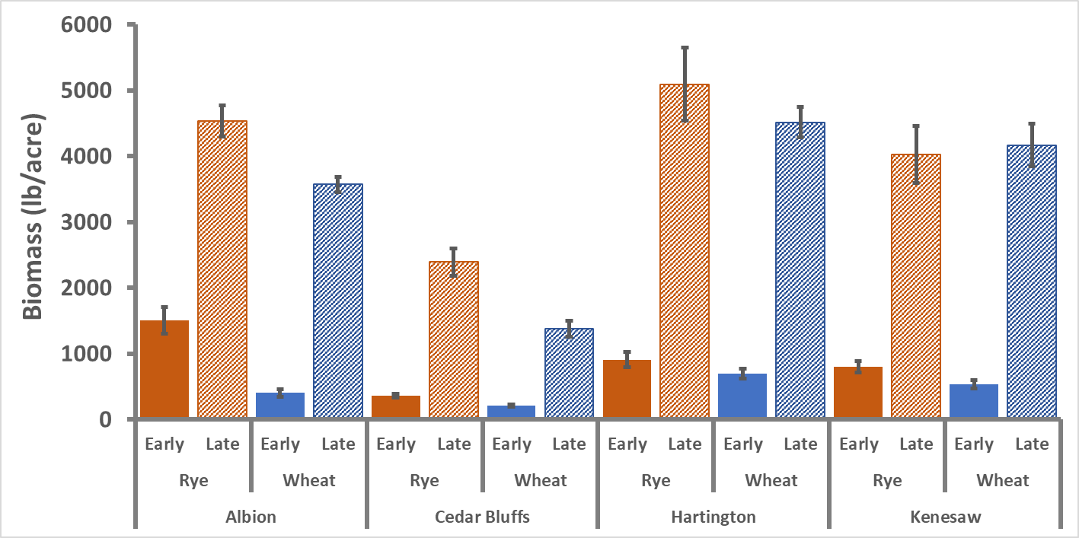

Slide 25
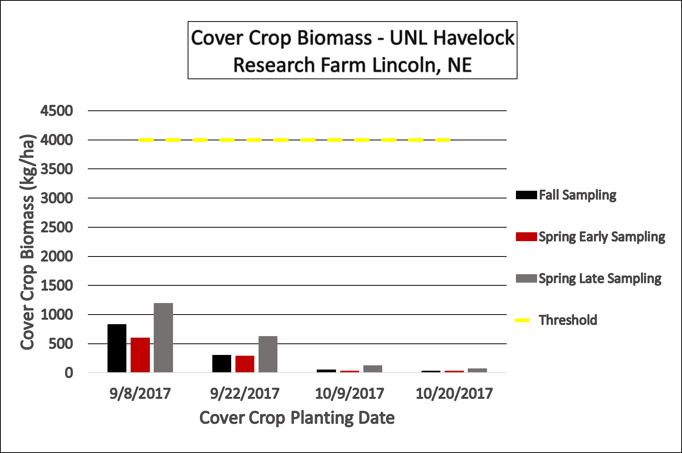
Results and Discussion
Cover Crop Biomass – Havelock
Discussion Points:
Around 3,500 lbs/ac of cover crop biomass required to suppress weeds
Unusually cool and dry spring in Nebraska
Notes:
4000 kg/ha is approx. 3500 lbs/ac
Discuss oats contributing to fall and late termination doubling biomass

Slide 26
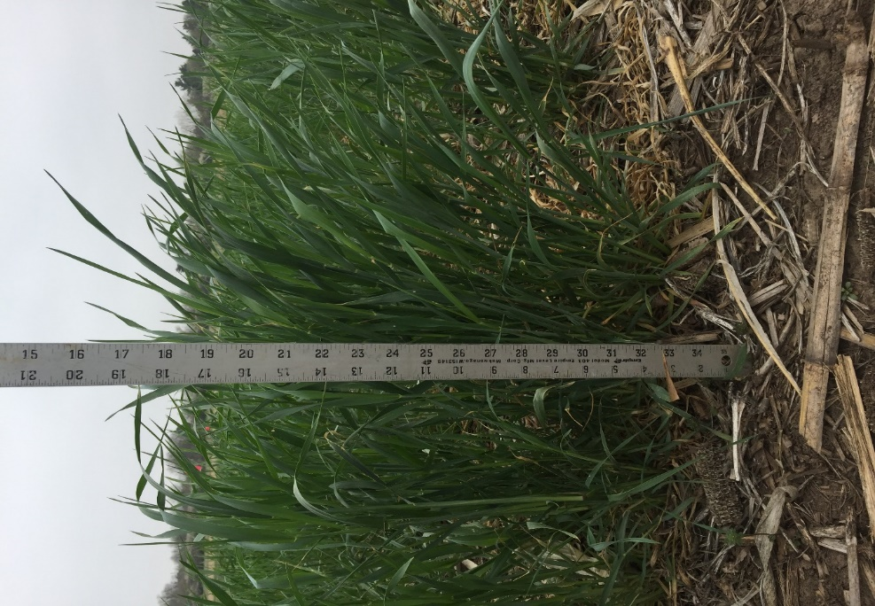
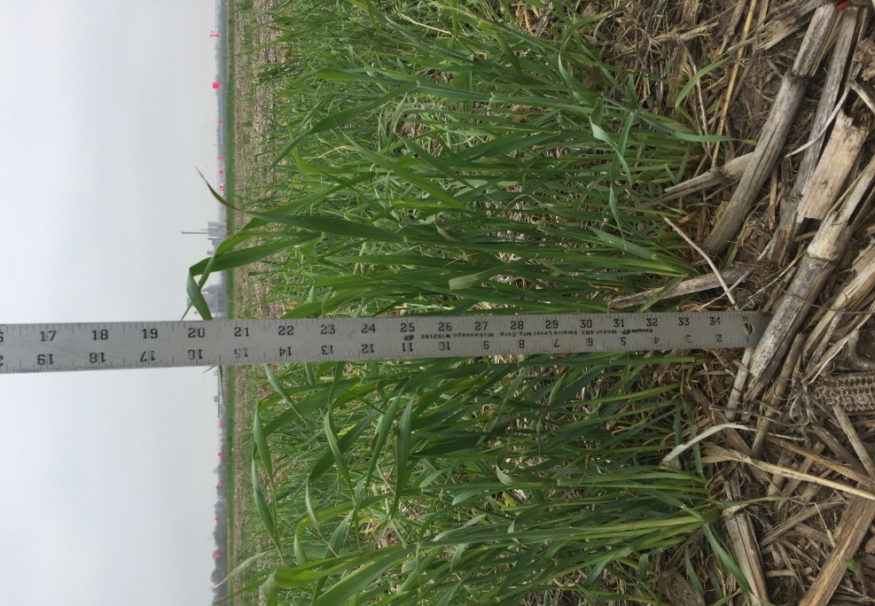
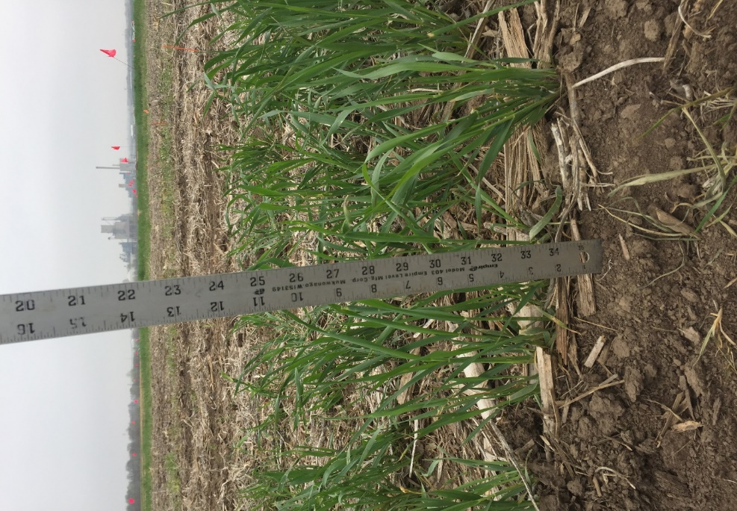
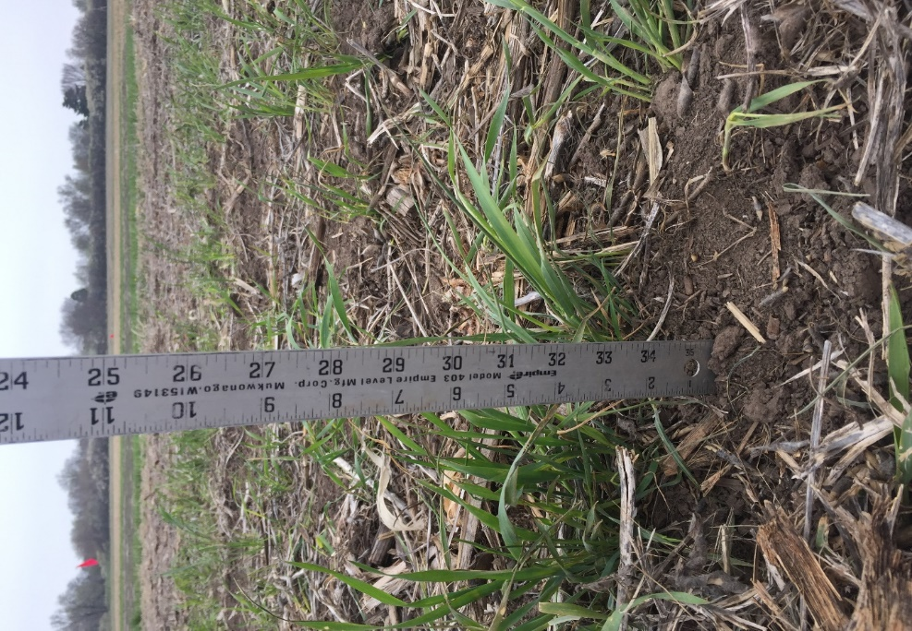
Results and Discussion
Cover Crop Biomass – Havelock
Planted 9/8/17
~ 19 Inches Growth
Planted 9/22/17
~ 14 Inches Growth
Planted 10/9/17
~ 8 Inches Growth
Planted 10/20/17
~ 5 Inches Growth

Slide 27
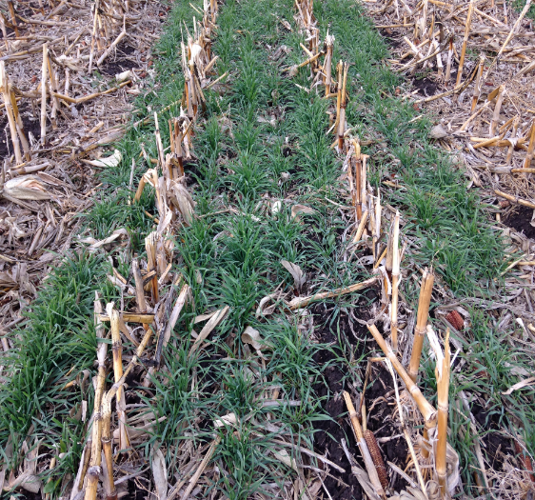
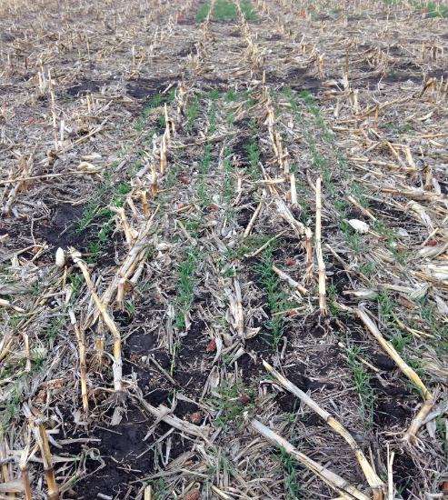
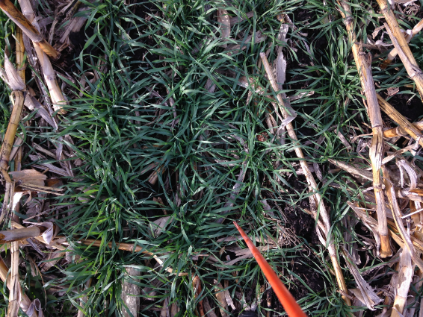
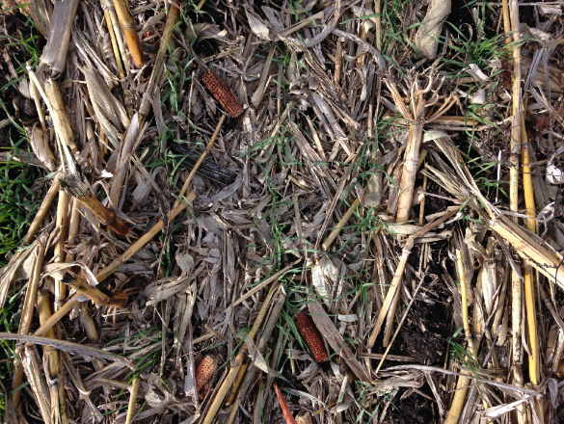
Cover Crop Biomass as affected by planting date
2-Oct
21-Oct
21-Oct
2-Oct
04/14/2016
12/8/2015
Notes:
Visual representation of different cover crop planting dates shown in fall and spring.

Slide 28
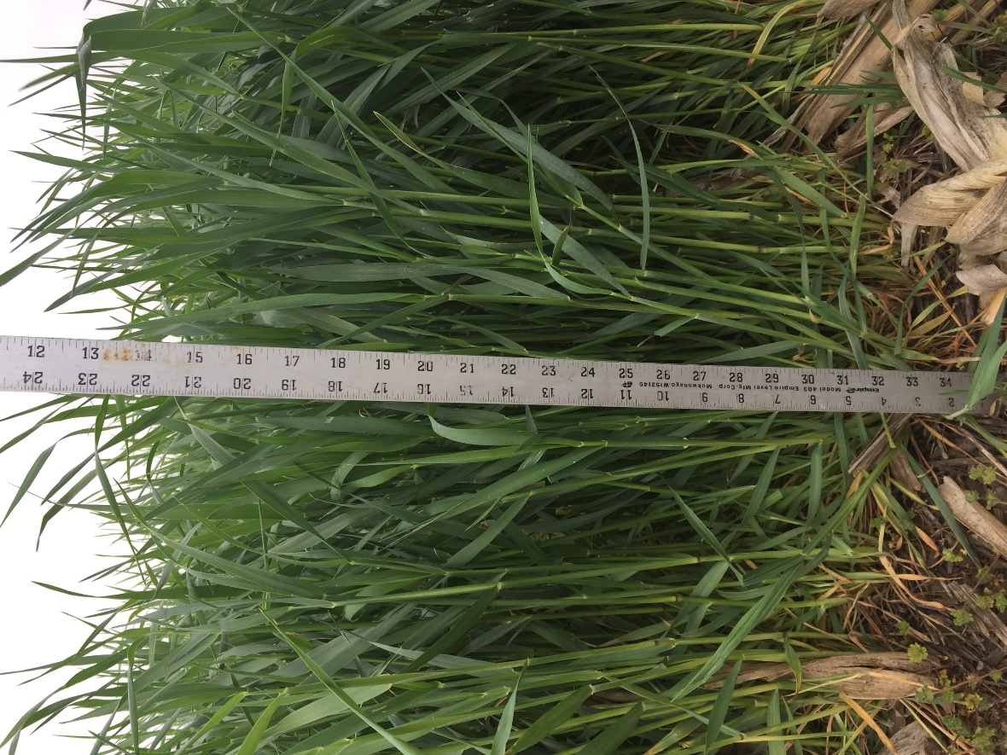
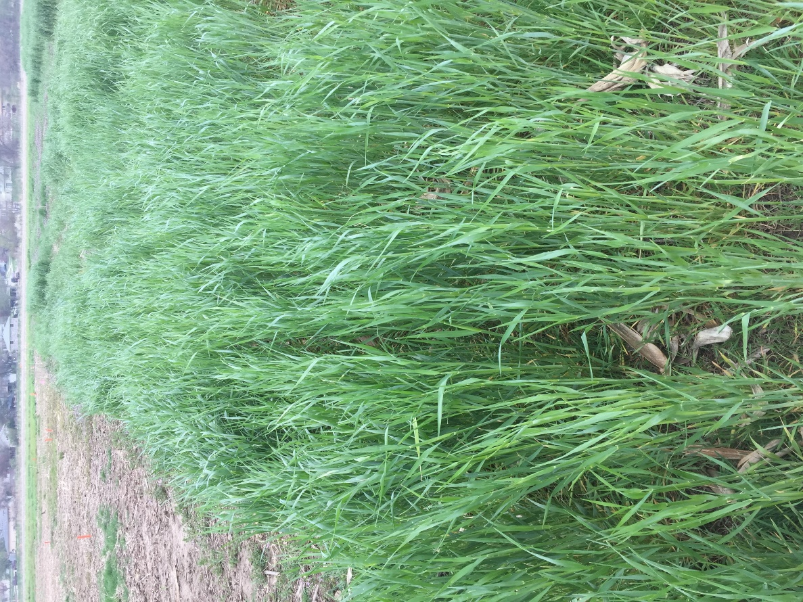
September 11
Notes:
Picture May 2
Planted Sept 11

Slide 29
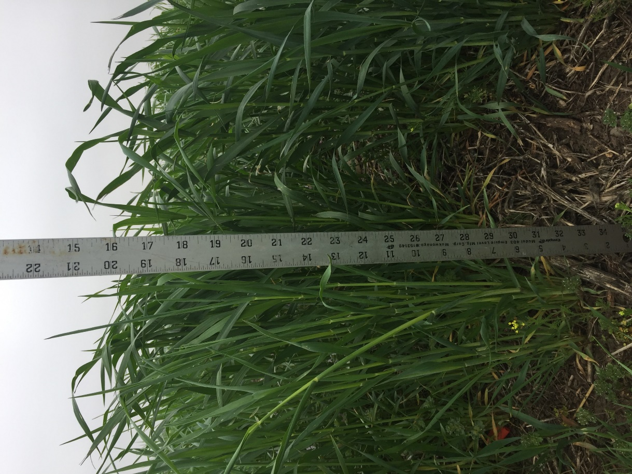
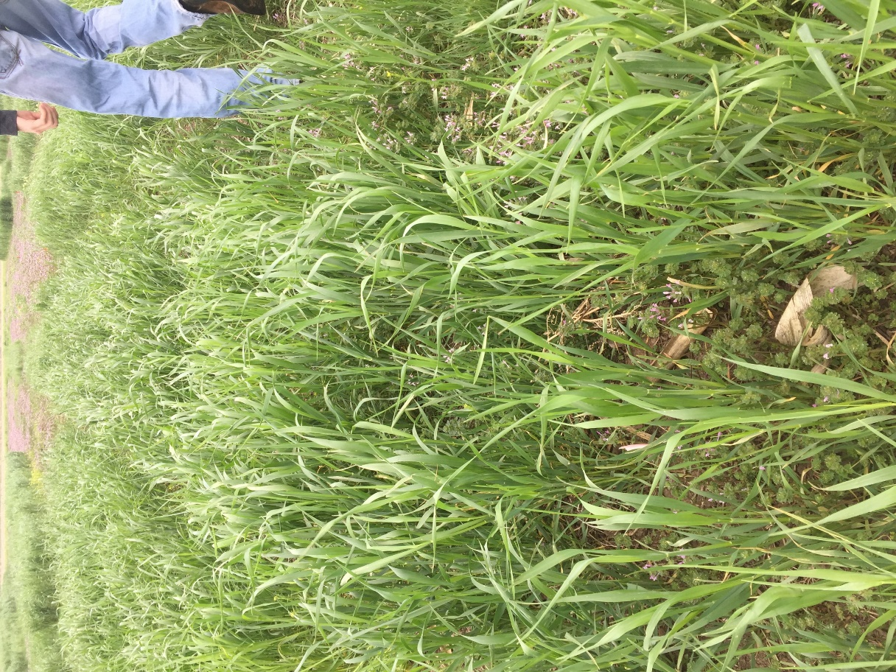
October 9
Notes:
Planted Oct 9

Slide 30
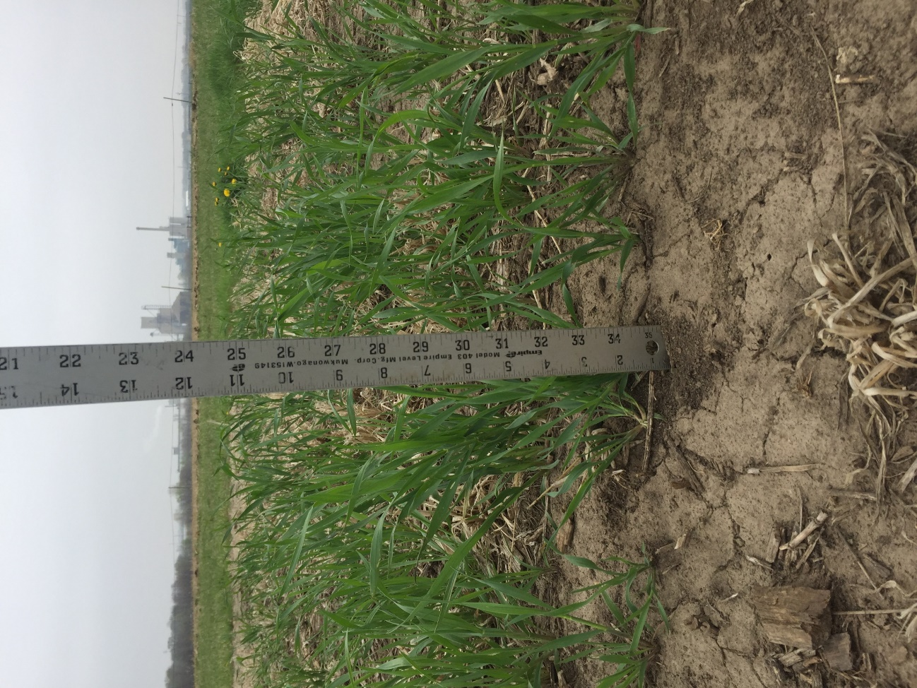
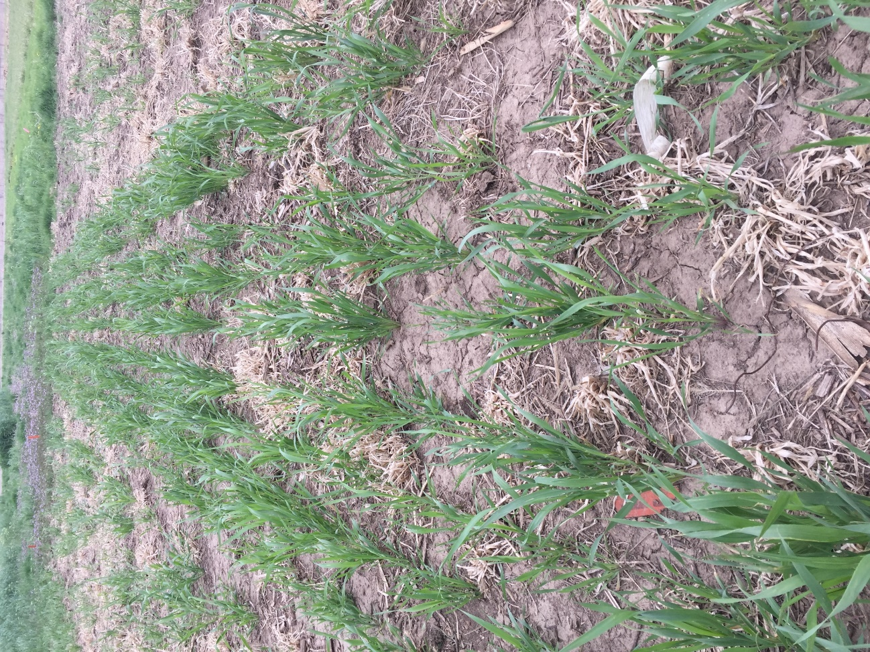
November 17
Notes:
Nov 17

Slide 31
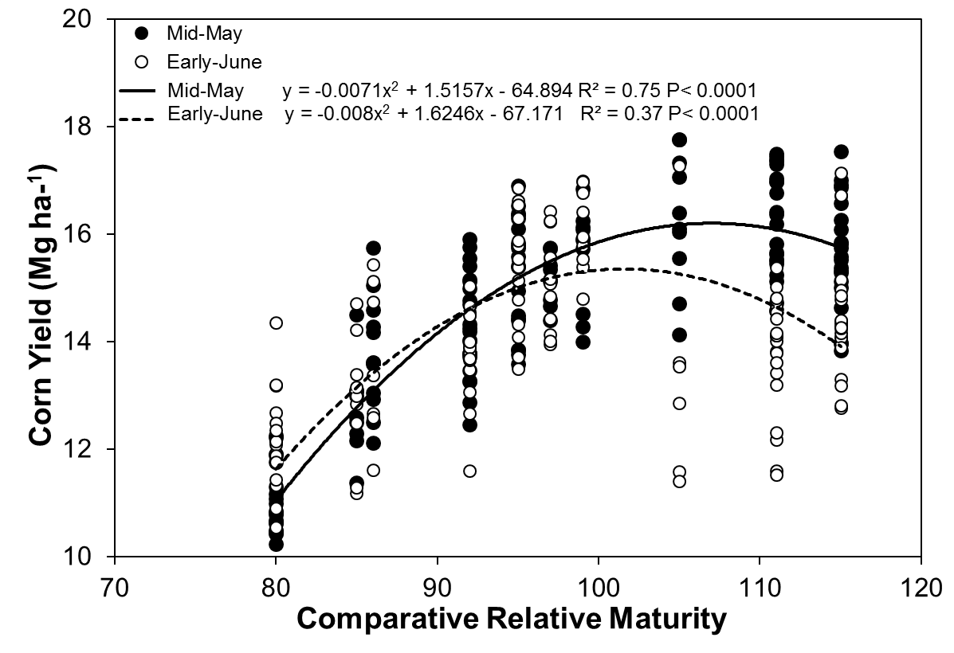
Notes:
Yield data from previous slide fit with a regression for the early and late planting dates.
Increasing CRM increased corn grain yield quadratically with the highest yield of 16.0 Mg ha-1 (238 bu/ac)obtained with the 107 CRM hybrid planted in mid-May and 15.3 Mg ha-1 (226 bu/ac) by 102 CRM hybrid when is planted in early-June.

Slide 32
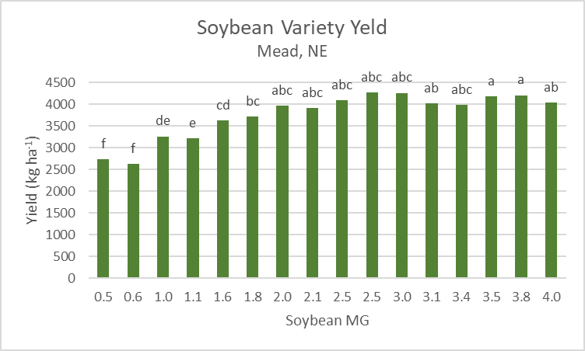

Slide 33
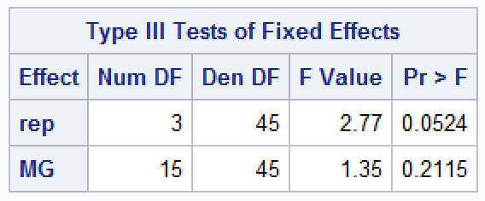
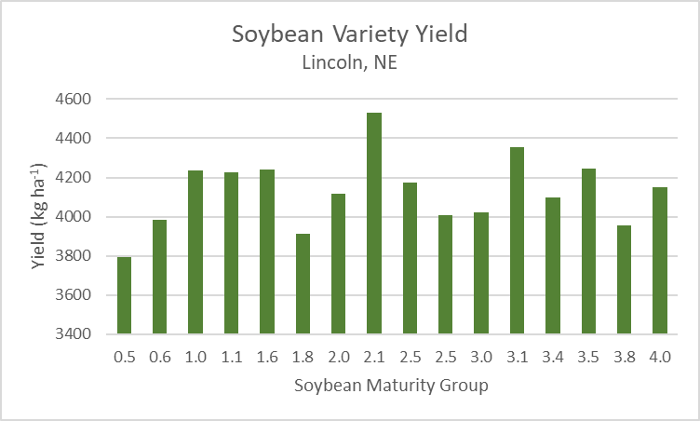

Slide 34
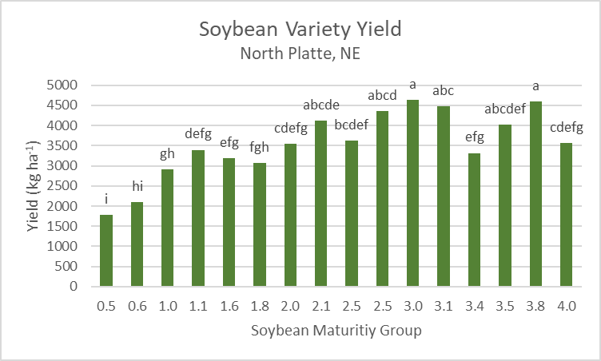

Slide 35
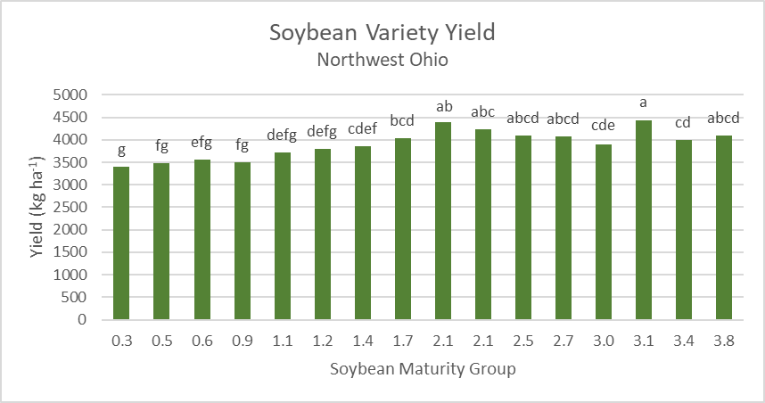

Slide 36
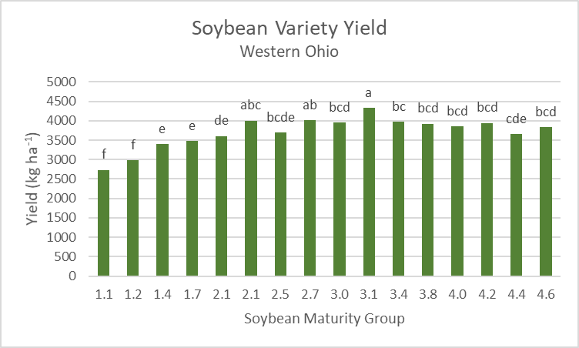

Slide 37
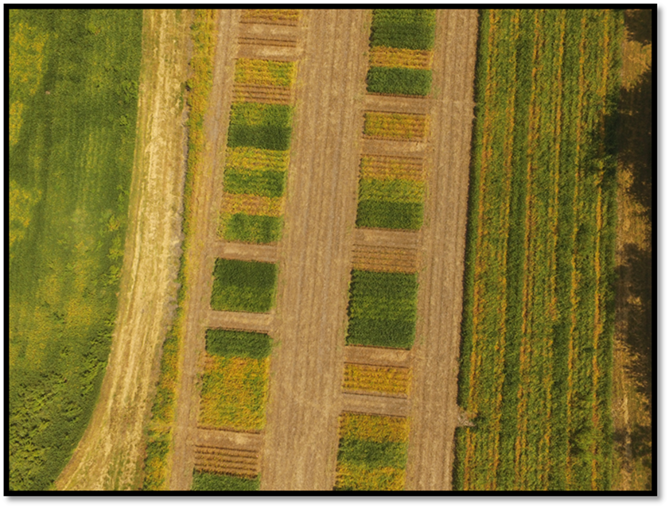

Slide 38
Cover crop impacts on Palmer amaranth
Chelsea McCall, 2017, MS research project
Palmer amaranth biomass and density prior to cover crop termination, May 18, 2015.
Aboveground cover crop biomass at termination, May 18, 2015
1000 g/m² = 4.46 ton/ac
Slide courtesy: Dr. Anita Dille KSU

Slide 39
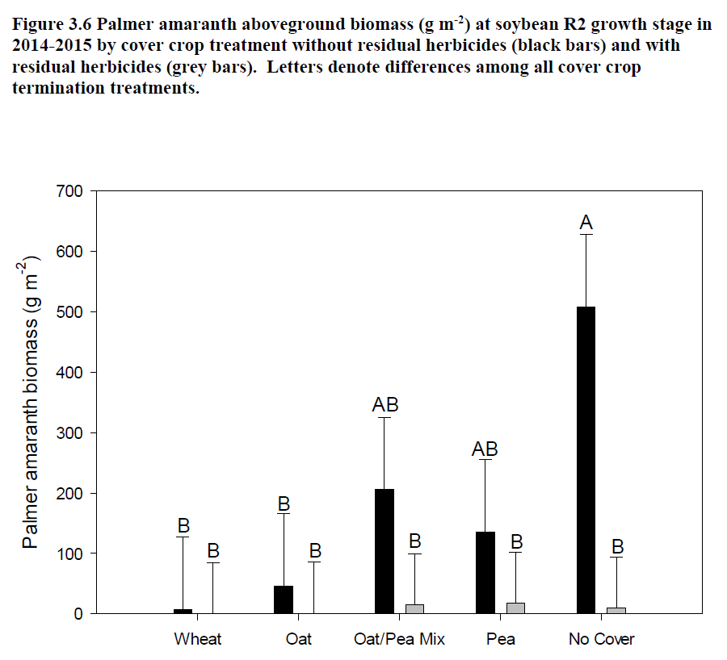
Results
Season-long Palmer Amaranth Emergence
No Cover: 5/19/2015
Soybeans were planted on 06/10/2015
Wheat: 6/12/2015
Oat: 6/9/2015
No cover
Wheat
Oat
Mix
Pea
Chelsea McCall, 2017, MS research project
Slide courtesy: Dr. Anita Dille KSU

Slide 40





Slide 41






Weed Management Systems Approach Study
Untreated
Weedy Control
CC Late-Terminated
NO CC
PRE fb POST
CC Early-Terminated
PRE fb POST
CC Late-Terminated
PRE fb POST
North Platte, NE (August 22, 2017)

Slide 42






April 22, 2017
Weed Management Systems Approach Study - Herbicide Program (Fall, Early-Spring, At Plant)
- Cereal Rye Cover Crop
- North Platte and Grant, NE
July 10, 2017

Slide 43


Yes CC

Slide 44
Opportunity for Further Research
Determine the optimum level of cover crop biomass that maximizes weed suppression but minimizes subsequent crop yield loss

Slide 45

Thanks!
Questions?
Chris Proctor, Ph.D., CCA
UNL Weed Management Extension Educator
Email: caproctor@unl.edu Phone: 402.472.5411
Twitter: @UNLWeedSci

